Slide 1

Azure Cloud Architect Nanodegree Amit Lathiya (Tutor)
Project 3 – Secure the Juice Store

Slide 2
Agenda
Ice Breaker
Project Walkthrough
Rubrics Walkthrough
Tips & Tricks
Questions

Slide 3
Ice Breaker Question
If you had to choose between only having a cell phone or a car for the rest of your life, which would you choose?

Slide 4
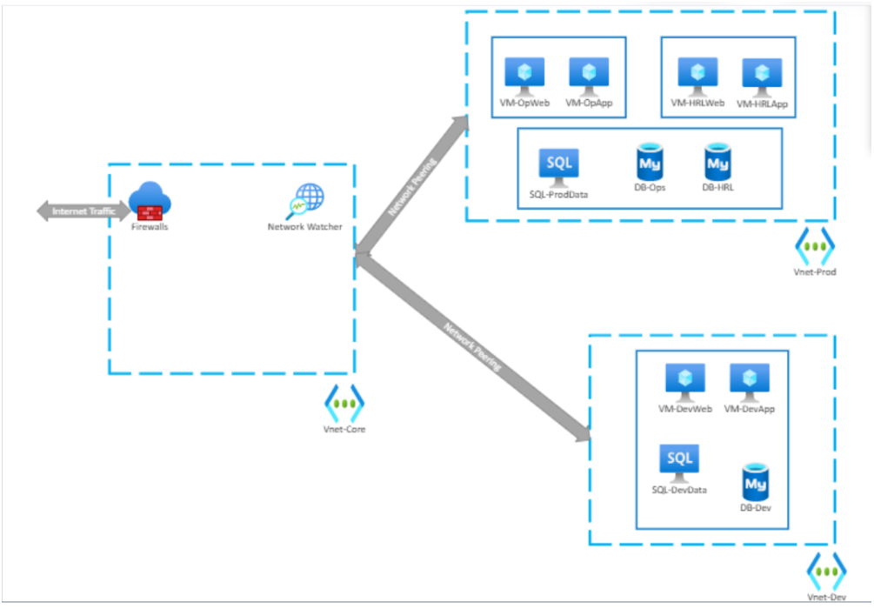
Project Walkthrough
Problem Statement
You are an Azure Cloud Architect for AKMade Enterprises. Your company is a medium-size business with a growing online presence and a desire to utilize the cloud for your IT enterprise. You have been asked to:
Ensure that the current architecture and deployment adhere to security and compliance policies.
Plan with security in mind
Plan and implement remediation where possible
Plan user roles according to least privilege

Slide 5
Step 1: IAM
Assign all AD Roles Refer to Concept 11 (Solution: Assign a role to a group), Lesson Identity, Authentication and Access
Global Admin settings: Set PIM to allow access for 8 hours for all eligible roles. No approvals are necessary, but the users must provide justifications and use MFA. Refer to Concept 20 (DEMO: Privileged Identity Management), Lesson Identity, Authentication and Access
Set Conditional Access policy for all users to enforce MFA Refer to Concept 13 (DEMO: MFA and Conditional Access), Lesson Identity, Authentication and Access
Set MFA Refer to Concept 13 (DEMO: MFA and Conditional Access), Lesson Identity, Authentication and Access
MFA tokens should expire every 14 days.
App passwords will not be allowed.
Only methods using a mobile app or hardware token will be allowed.
The Charlotte office is considered a trusted site
MFA should not be required in the Charlotte Office.
The Charlotte office has an IP address range of 143.52.0.0/24

Slide 6
Step 2: Network and Infrastructure Security
Configure Azure Bastion so that it may access all virtual machines. Refer to Concept 12 (DEMO: Azure Bastion), Infrastructure and Network Security
Ensure virtual machines do not have a public IP address Refer to Concept 13 (DEMO: Securing Virtual Machines), Data Security and Protection
Note: While working on the VMs, do not make any configurations to the host VM "VM-WS16DevWeb" and its related resources.
Step 3: Data Security and Protection
Enable encryption at rest for all VMs [do not make any configurations to the host VM "VM-WS16DevWeb"] using the customer-managed key for Key Vault encryption Refer to Concept 13 (DEMO: Securing Virtual Machines), Data Security and Protection, Refer to Concept 11 (Solution: Exercise: Key Vault and Disk encryption Set), Data Security and Protection
Configure Firewall and network rules to not allow public network access on TLS 1.2 only. Refer to Concept 21 (Solution: Secure Database Access), Lesson Data Security and Protection
Enable Defender for SQL server (Microsoft Defender for SQL - Azure SQL Database | Microsoft Docs)
Set SQL to use Azure AD authentication Refer to Concept 21 (Solution: Secure Database Access), Lesson Data Security and Protection

Slide 7
Step 4: Cloud Protection
Add extension IaaS Antimalware on VMs Refer to Concept 13 (DEMO: Securing Virtual Machines), Data Security and Protection
Using Azure Security Center, determine the top 3 remediation's that will have the greatest impact on security, based on the security score. You do not need to actually implement these, changes, but justify your selection and describe what the action steps would be to implement. If you do not have 3 score impacting vulnerabilities check for best practices you can or might implement. Refer to Concept 4 – 1nd Video (Demo: Security Center), Lesson Protect and Monitor Cloud Resources
Step 5: Monitoring
Configure SQL Auditing with Log Analytics Refer to Concept 21 (Solution: Secure Database Access), Lesson Data Security and Protection
Configure Sentinel data connectors Refer to Concept 13 (Solution: Azure Sentinel), Lesson Protect and Monitor Cloud Resources
Azure Active Directory Identity Protection
Azure Defender
Step 6: Compliance
You have learned you will have a new requirement to be compliant with NIST SP 800-53 rev.4 policies. You will need to add this configuration to Security Center. Refer to Concept 4 – 2nd Video (Demo: Security Center), Lesson Protect and Monitor Cloud Resources

Slide 8
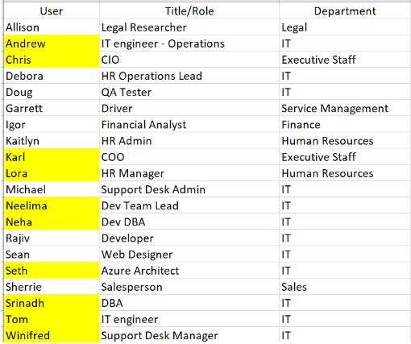
Project Instructions
You will demonstrate your knowledge and understanding of the four keys areas of security.
Always keep the concepts of Zero Trust in mind!

Slide 9
What you need to know in order to properly configure Azure
The Charlotte home office is the only trusted network. It has an IP address range of 143.52.0.0/24 .
RBAC and Least Privilege Considerations – (PIM)
All Executive and IT staff will have active Message Center Reader roles
Remember to use Groups and assign roles to groups as appropriate
Support Desk staff will require Help Desk Admin roles on an as-needed (eligible) basis to perform their job function.
The COO will have the Billing Admin role active.
The Azure Architect will be eligible for the Global Admin and Billing admin roles. They will also have full access to all the Azure infrastructure with the ability to assign Azure roles as needed.
The CIO will not continually work in the environment however, they will need the same Azure AD access should the need arise to step in for the Azure Architect.
The Human Resources staff will need the User Admin role on occasion (eligible).
The lead DBA will need access to all SQL infrastructure and data, but the Development DBA will only need to access the Dev Database.
The IT Engineers and the Development Lead will each need access to their assigned environments but will not need to provide this access to others.

Slide 10
Identity and Access Management
CRITERIA | MEETS SPECIFICATIONS
Design authentication and authorization controls that manage access, role assignments, and identity | Screenshot(s) that clearly display all Azure AD roles and Azure AD Assignments for all required users. Screenshot(s) that clearly displays Global Admin PIM screen showing duration, eligibility, and expiration
Configure MFA and Conditional Access policies to require MFA for all users. | Screenshots of Conditional Access policy that clearly demonstrates that MFA has been configured for all users. Screenshots of Multi-Factor authentication configuration pages that clearly demonstrate the stated requirements here: MFA tokens should expire every 14 days. The Charlotte office is considered a trusted site MFA should not be required in the Charlotte Office. The Charlotte office has an IP address range of 143.52.0.0/24

Slide 11
Network Security
CRITERIA | MEETS SPECIFICATIONS
Configure Azure Bastion to allow secure connectivity from the Azure Portal to the Azure Virtual machines. | Screenshot of the Bastion Overview page should indicate the virtual network/subnet. Placed correctly, only one Bastion will be needed.
Reduce attack footprint by removing public IP addresses. | The screenshot clearly shows public IP address is blank for each VM
Data and Encryption
CRITERIA | MEETS SPECIFICATIONS
Protect data at rest by encrypting data disks using a customer-managed key | Screenshots should show the disk encryption type for each VM.
Secure traffic to SQL servers and databases by limiting public network access, enforcing TLS minimum requirements, and setting allowed IPs or network requirements | A screenshot of the Firewalls and Virtual networks page for SQL servers that clearly shows the required configuration for no public access and TLS
Protect SQL data by enabling Azure Defender for SQL. | Screenshot that shows Azure Defender for SQL is enabled.
Secure Azure SQL by enforcing Azure AD authentication over the weaker SQL authentication methods. | Show screenshot of Azure AD authentication for SQL enabled

Slide 12
Protection
CRITERIA | MEETS SPECIFICATIONS
Protect virtual machines from malware by using available extensions. | Screenshot of the extensions tab for all VM shows anti-malware is enabled
Track and remediate vulnerabilities against Azure Security Center (ASC) Default policy | A list of at least 3 recommendations with the justification to remediate vulnerabilities(text file)
Monitoring
CRITERIA | MEETS SPECIFICATIONS
Configure Azure Sentinel Connectors. | Provide screenshot of Azure Sentinel Data Connectors Page. At least Azure Active Directory and Azure Active Directory Identity Protection connectors should be selected
Monitor and Protect SQL databases by configuring auditing. | Provide screenshot showing SQL Auditing is enabled with Log Analytics Workspace
Compliance
CRITERIA | MEETS SPECIFICATIONS
Enable monitoring of established industry and regulatory standards | Screenshot proof of added NIST SP 800-53 rev4 policy

Slide 13
Tips & Tricks
Refer to the exercise where you are stuck. Have provided the links to Demos and Solution Videos from Exercise.
Go through Microsoft Azure Documentation
Go through rubrics requirement thoroughly
Re-read the problem statement
Ask question in slack channels for confusion

Slide 14
QUESTIONS

